Slide 1
ENGINEERING ECONOMIC ANALYSIS
Time Value of Money
& Simple Interest
主讲人：Team 11

Slide 2
Learning Objective
01
02
03
04
Time Value Concept
Simple Interest
Cash Flow Diagrams
Equivalence

Slide 3
Part 01
Time Value

Slide 4

Why Money Has Time Value
Inflation
The purchasing power of money decreases over time due to inflation. $100 today buys more than $100 in the future.
Risk & Uncertainty
Future payments carry risk. Money received today is certain, while future payments may not materialize.
Opportunity Cost
Money today can be invested to earn returns. Delaying receipt means losing potential earnings.
Time Preference
People generally prefer immediate consumption over delayed gratification. Present goods are valued more highly.

Slide 5
"A dollar today is worth more than a dollar tomorrow because it can be invested to earn a return."
1、Interest compensates for the time value of money
2、 Engineering economics quantifies this relationship
3、 All financial decisions must consider time value

Slide 6
Part 02
Interest

Slide 7
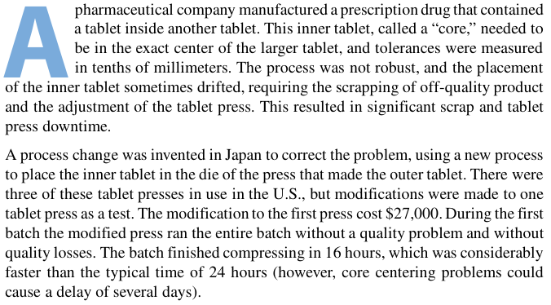
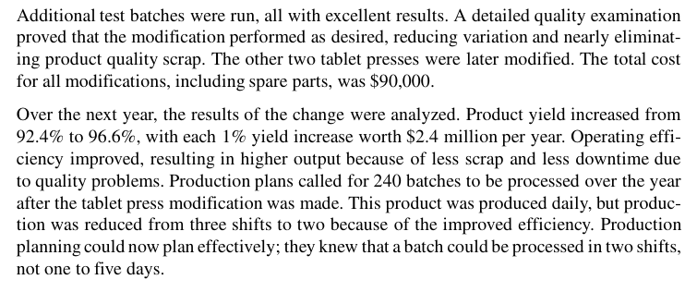
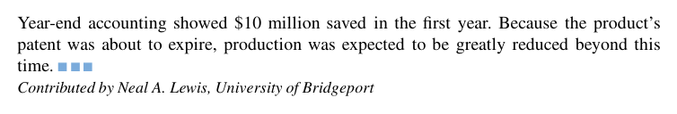
01.
A Prescription for Success(case introduction)
BASIC DEFINITIONS

Slide 8
03.
Concepts
BASIC DEFINITIONS
What is Interest?
Principal (P)
Interest is the compensation paid for the use of borrowed money or the return earned on invested money.
The initial amount of money invested or borrowed.
Key Idea: Interest represents the time value of money in action.
P = Initial Investment or Loan Amount
Interest Rate (i)
Time Period (n)
The percentage of the principal charged as interest per time period.
The duration over which interest is calculated, typically in years.
i = Interest per period / Principal
n = Number of periods (usually years)

Slide 9
04.
In this case
Explanations of the case situation
01
What is Interest?
02
Principal (P)
Interest = Annual profit from improvement = $10.08 million This is the compensation/return for investing the $90,000.
P = the money invested in the process improvement
That is：$90,000 total modification cost This is the initial amount of money invested to get future returns.
03
Interest Rate (i)
04
Time Period (n)
i = the annual return rate generated by the improvement We calculate it as:
Yield improvement: 4.2% Each 1% = $2.4 million/year Annual benefit = 4.2 × 2.4 = $10.08 million
So: i = Annual return / Investment = $10,080,000 / $90,000 = 112% per year This is the rate of return on the investment — exactly like an interest rate.
n = years over which returns are earned The case says: “Over the next year, the results were analyzed.” “Production plans called for 240 batches over the year.”
So n = 1 year (the first period of return).
In financial terms: n = time period during which interest/return accumulates

Slide 10
Simple Interest
Simple interest is interest that is computed only on the original sum, not on accrued interest.
Thus if you were to loan a present sum of money P to someone at a simple annual interest rate i (stated as a decimal) for a period of n years, the amount of interest you would receive
from the loan would be
Total interest earned = P × i × n = Pin (3-1)
At the end of n years the amount of money due you, F, would equal the amount of the loan P plus the total interest earned. That is, the amount of money due at the end of the loan
would be
F = P + Pin (3-2)
or F = P(1 + in).

Slide 11
Part 3
Cash Flow Diagrams Formula

Slide 12
01.
What is a Cash Flow Diagram?
- Graphical representation of cash inflows/outflows over time
- Essential for engineering economic analysis
Key Elements:
Horizontal time axis
↑ Upward arrows = Cash inflows (+)
↓ Downward arrows = Cash outflows (-)

Slide 13
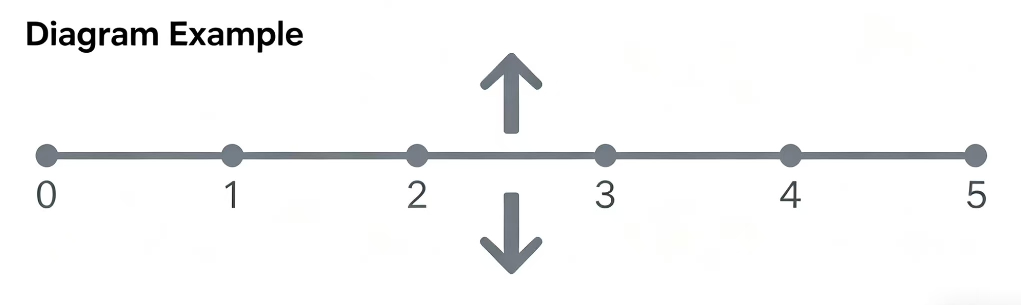
02.
Drawing Rules
1. Time increases left to right
2. ↑ Up arrows = Inflows (positive)
3. ↓ Down arrows = Outflows (negative)
4. Arrows at period END (unless specified)

Slide 14
03.
Borrower vs. Lender Perspective
Borrower (Loan):
Year 0: ↑ $5,000
Year 5: ↓ $6,250
Lender (Investment):
Year 0: ↓ $5,000
Year 5: ↑ $6,250
Note: 5% simple interest over 5 years
+5000
0
5
-6250
+6250
0
5
-5000

Slide 15
04.
Cash Flow Diagram Example
Project: Initial investment $10,000, then $3,000 annual income for 4 years
Year: ↑ ↑ ↑ ↑
0 1 2 3 4
↓
$10K $3K $3K $3K $3K
Summary (undiscounted):
Total Outflow: $10,000
Total Inflow: $12,000
Net Gain: $2,000

Slide 16
Part 4
Equivalence

Slide 17
01.
What is Equivalence?
Two or more cash flows are equivalent at a given interest rate if they have the same economic value. This means they can be exchanged without financial advantage or disadvantage.
Equivalence depends on the interest rate. The same cash flows may not be equivalent at different rates.

Slide 18

02.
Equivalence Example
You have agreed to loan a friend $5000 for 5 years at a simple interest rate of 8% per year. How much interest will you receive from the loan? How much will your friend pay you at the end of 5 years?
Total interest earned = Pin = ($5000)(0.08)(5 yr) = $2000
Amount due at end of loan = P + Pin = 5000 + 2000 = $7000
At 8% interest:
$1,000 today ≡ $1,469 in 5 years
Because: F = 1000(1 + 0.08×5) = $1,400 (simple interest)

Slide 19
03.
Applications of Equivalence
Convert all cash flows to equivalent values at the same point in time for fair comparison
Different payment schedules can be equivalent if they have the same present value.
Determine if different investment opportunities offer equivalent returns
Comparing Alternatives
Loan Repayment Options
Investment Analysis
Example: Project A with $100 now and $150 in 2 years vs. Project B with $200 in 3 years, converted to present value using 5% rate rate.
Example: 5-year loan with monthly payments of $200 vs. 3-year loan with monthly payments $350, 5 payments, both having value of $10,000.
Example: Stock A with 10% annual return vs. Bond B with 8% annual return plus 2% dividend, evaluated for with monthly total returns.

Slide 20
Practice Problems

Slide 21
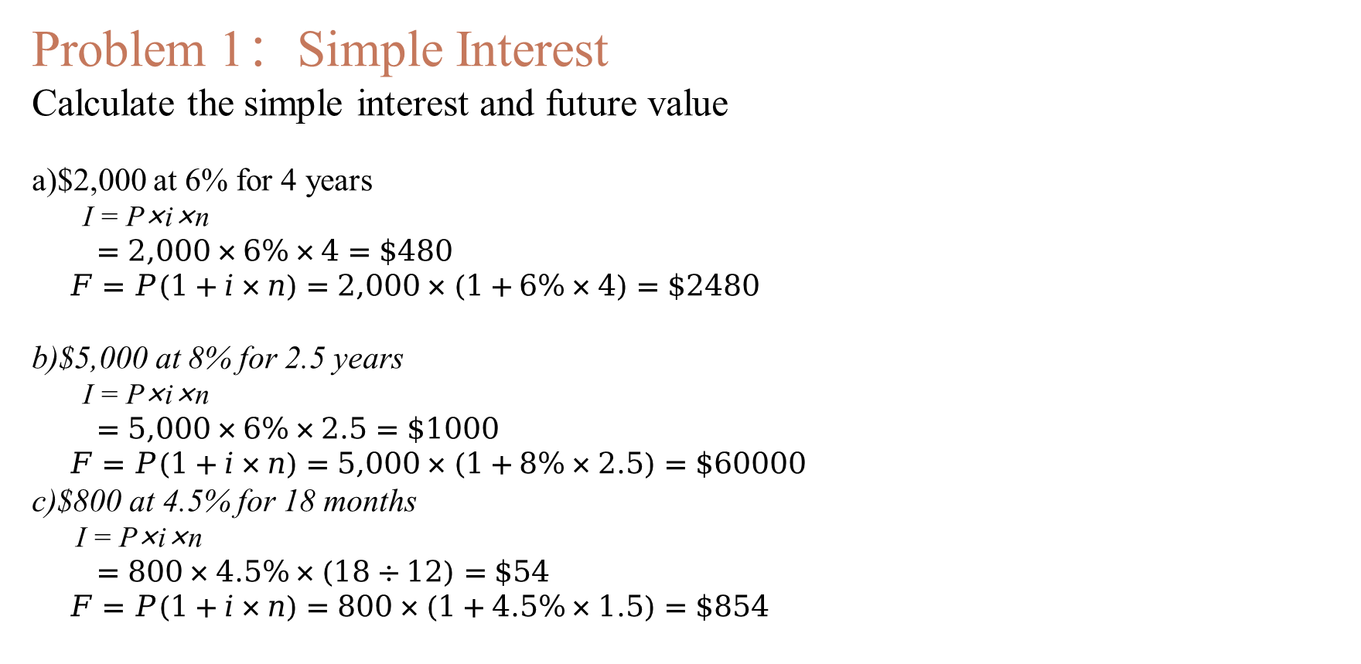
Problem 1：Simple Interest
Calculate the simple interest and future value
a)$2,000 at 6% for 4 years
I = P×i×n
$=2,000×6\%×4=\$480$
$F=P(1+i×n)=2,000×(1+6\%×4)=\$2480$
b)$5,000 at 8% for 2.5 years
I = P×i×n
$=5,000×6\%×2.5=\$1000$
$F=P(1+i×n)=5,000×(1+8\%×2.5)=\$60000$
c)$800 at 4.5% for 18 months
I = P×i×n
$=800×4.5\%×(18÷12)=\$54$
$F=P(1+i×n)=800×(1+4.5\%×1.5)=\$854$

Slide 22
Problem 2：Cash Flow Diagrams
Draw cash flow diagrams for :
a) Borrowing $3,000,repaying $3,500 after 2 years at 8.33%simlpe interest
+$3,000
-$3,500
输入标题
b) Investing $5,000,receiving $6,000 after 3 years at 6.67% simple interest
-$5,000
+$6,000

Slide 23
Problem 3：Equivalence
At 7% simple interest, what amount in 4 years is equivalent to $2,500 today?
Solution approach: Use F = P(1 + i×n)
F = 2500(1 + 0.07×4) = $3,200
Verify:
Today's $2,500, when deposited at a simple interest rate of 7% for 4 years, amounts to $3,200 in principal and interest. Therefore, $3,200 in 4 years = today's $2,500.

Slide 24

Problem 4：Comparison
Compare simple interest earnings:
Option A: $10,000 at 5% for 5 years
I = P×i×n
$=10000×0.05×5=\$2,500$
$F_{A}=10000+2500= \$12500$
Option B: $10,000 at 8% for 3 years
I = P×i×n
$=10000×0.08×3=\$2,400$
$F_{A}=10000+2500= \$12500$
Conclusion: Option A yields higher interest

Slide 25
Key Take aways

Slide 26
01.
Time Values
Time value of money: The continuing offer of banks to pay interest for the temporary
Use of other people’s money is ample proof that there is a time value of money.
Thus, we would always choose to receive $100 today rather than the promise of $100 to be paid at a future date
02.
Simple interest
I = P × i × n. Interest is calculated only on the principal amount, not on accumulated interest.
03.
Cash Flow Diagrams
Visual representation of cash flows over time. Up arrows = inflows, down arrows = outflows.

Slide 27
Thank you！
主讲人：

